Slide 1

Application Design
Nicklas Andersen

Slide 2
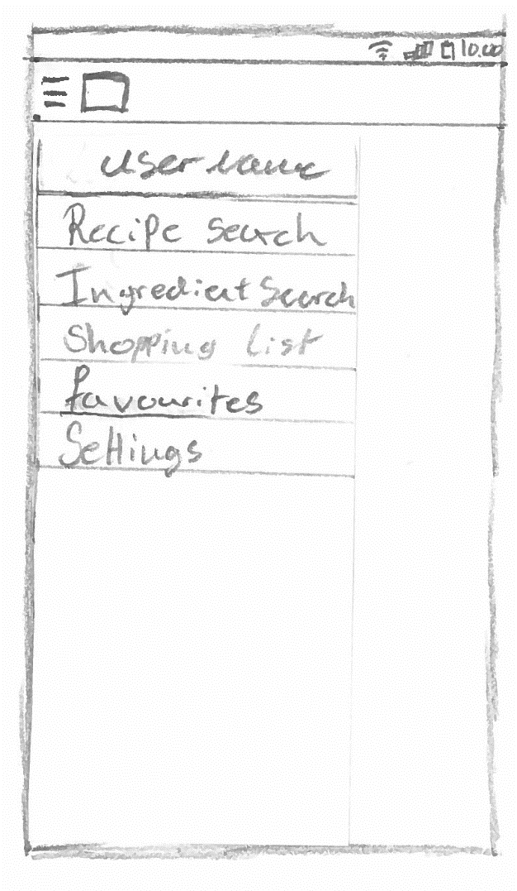
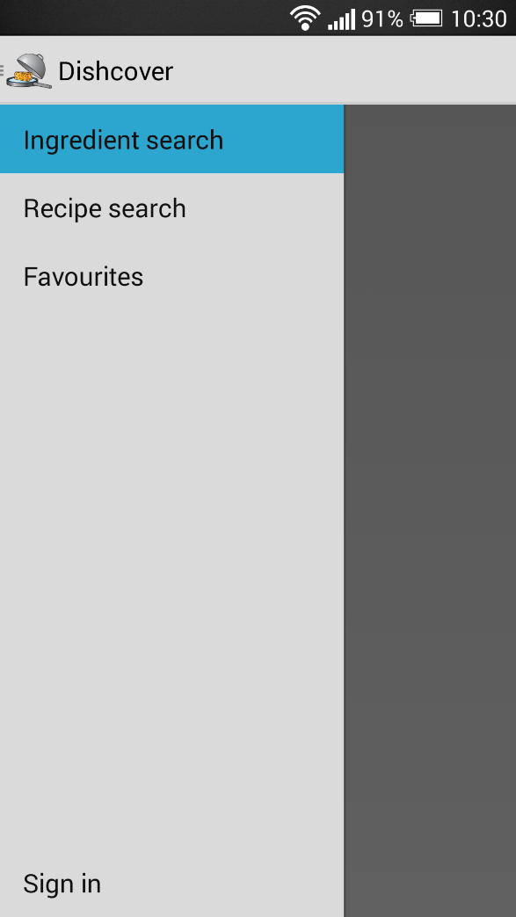
Motivation
concept
App design
Floor plan
Website
Server communication
conclusion
demonstration
Navigation drawer
9 OF 32 | 15.02.2014
Department of computer science
AALBORG UNIVERSITy

Slide 3
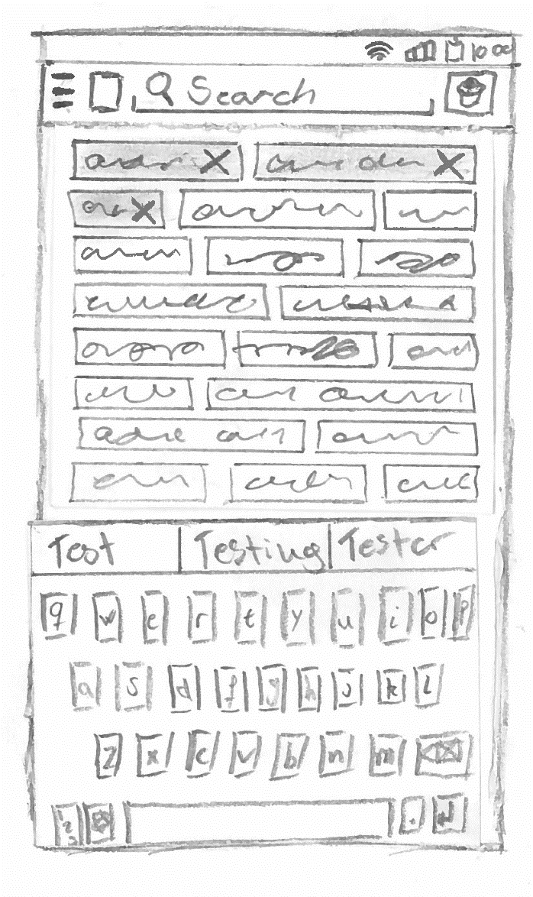
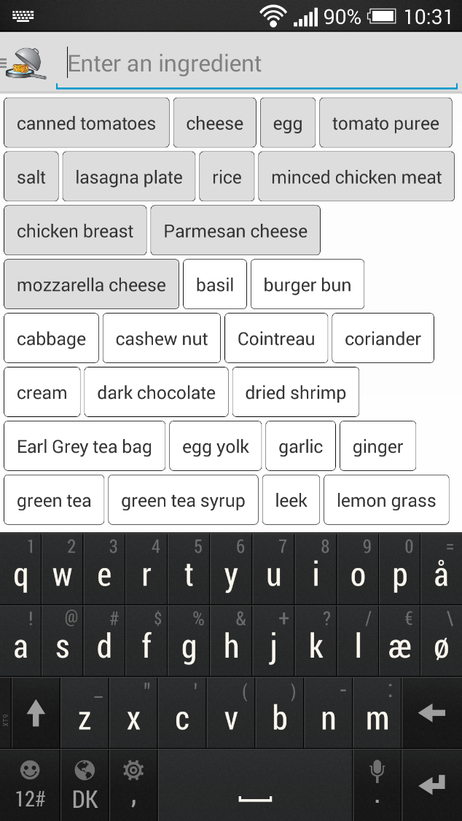
Motivation
concept
App design
Floor plan
Website
Server communication
conclusion
demonstration
Ingredient search
10 OF 32 | 15.02.2014
Department of computer science
AALBORG UNIVERSITy

Slide 4
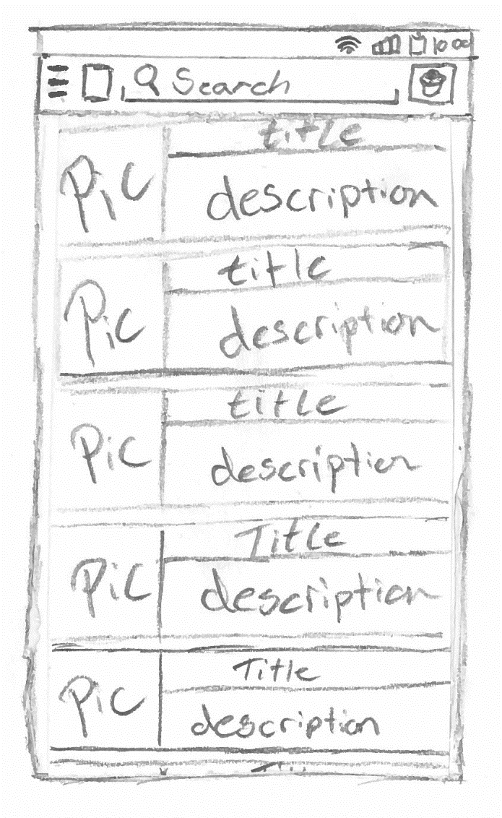
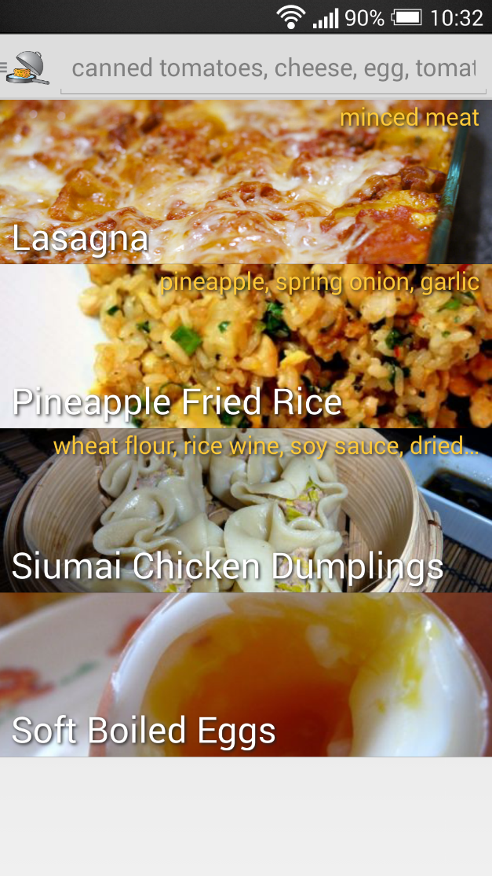
Motivation
concept
App design
Floor plan
Website
Server communication
conclusion
demonstration
Result list
11 OF 32 | 15.02.2014
Department of computer science
AALBORG UNIVERSITy

Slide 5
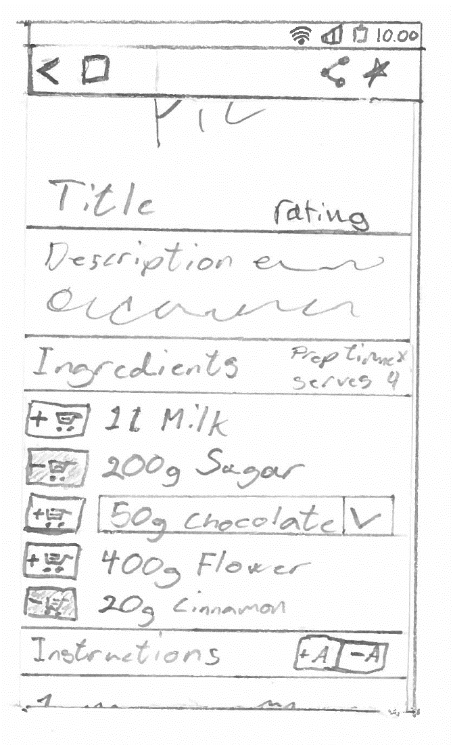
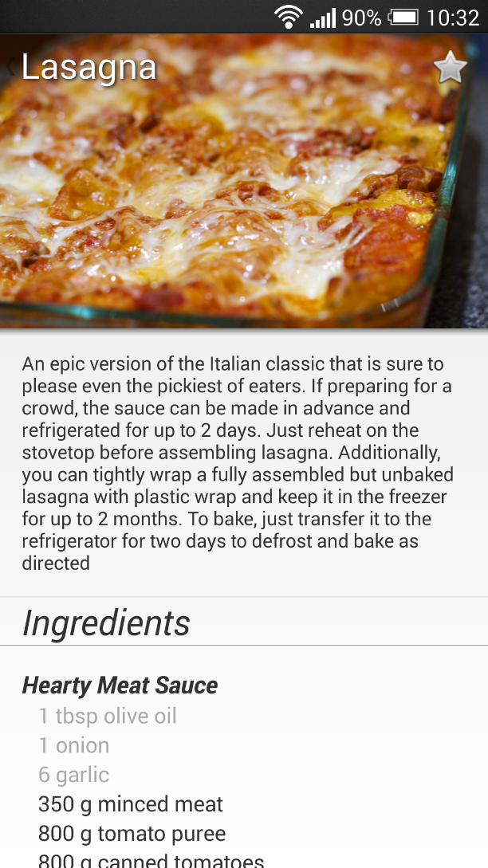
Motivation
concept
App design
Floor plan
Website
Server communication
conclusion
demonstration
Recipe
12 OF 32 | 15.02.2014
Department of computer science
AALBORG UNIVERSITy

Slide 6

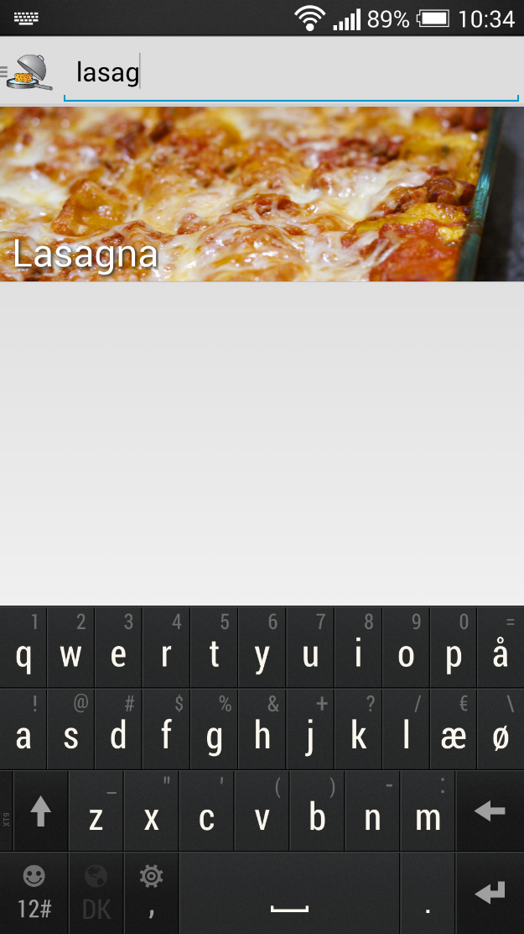
Motivation
concept
App design
Floor plan
Website
Server communication
conclusion
demonstration
Test search
13 OF 32 | 15.02.2014
Department of computer science
AALBORG UNIVERSITy

Slide 7
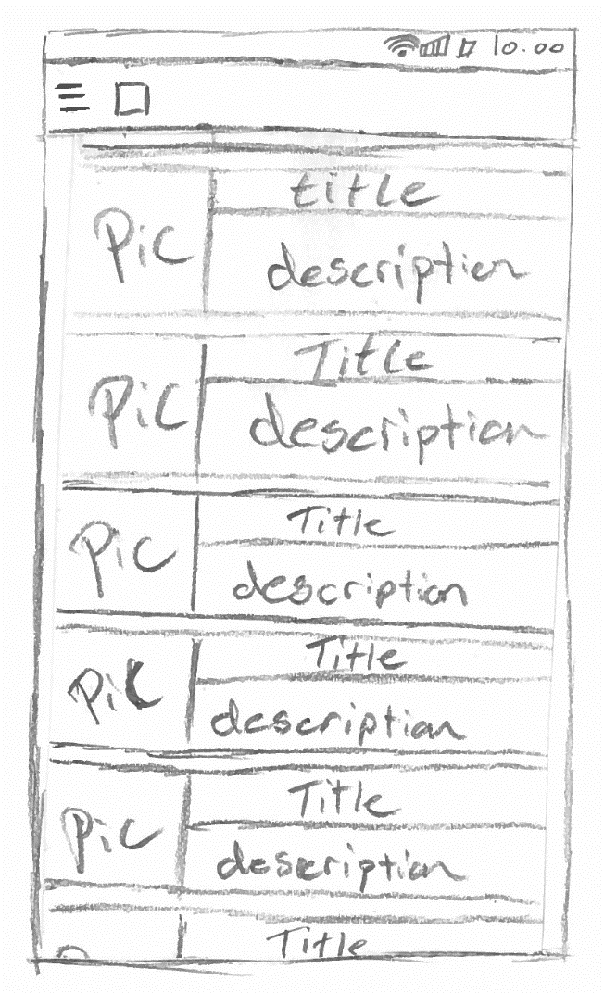
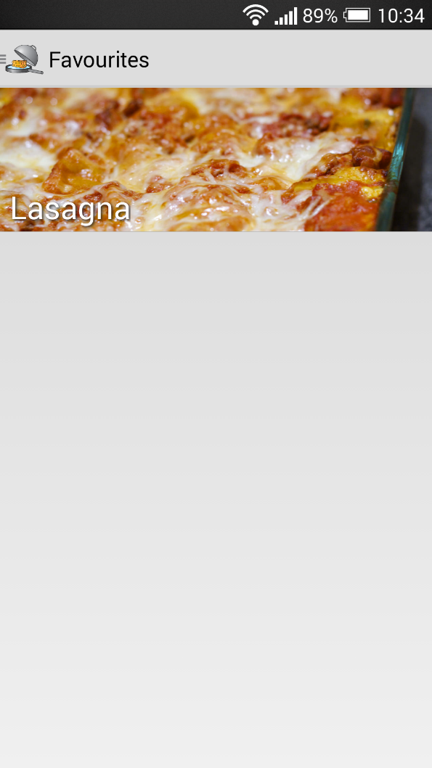
Motivation
concept
App design
Floor plan
Website
Server communication
conclusion
demonstration
Favourites
14 OF 32 | 15.02.2014
Department of computer science
AALBORG UNIVERSITy

Slide 8
Conclusion
Jacob K. Wortmann

Slide 9
Motivation
concept
App design
Floor plan
Website
Server communication
conclusion
demonstration
Conclusion
implemented website tool, android application, and a server service
Personalise the application
The three parts functions and work well with each other
WE believe that the application will help navigation issues
Future work
31 OF 32 | 15.02.2014
Department of computer science
AALBORG UNIVERSITy
Notes:
- We implemented all the three parts of the system, we did this to get a more final result at the end of the semester, but also to
gain knowledge and experiance with different technologies, and the difficulty of getting them to work together.
- The user can personilise the information that is recieved by subscribing to booths of their liking, meaning that
they will not get spam from booths that they are of no interest.
- We have tested the Server Communication layer and found that it always returns a valid JSON format to the application,
We have also tested the android application, and found that its functionalities works.
- We believe that the application will help and help users with navigation, but also aid the users to get a better overview
of the exhibition.
- Since we implemented all three parts of the system, means that there are a lot of good features that can implemented
to further extend the capabilities of the application.

